Slide 1

MULTICHANNEL GIFT COMPANY

Slide 2
Agenda
Company Details
Primary Question
Data
Tool used
Findings
Insight and Recommendations

Slide 3
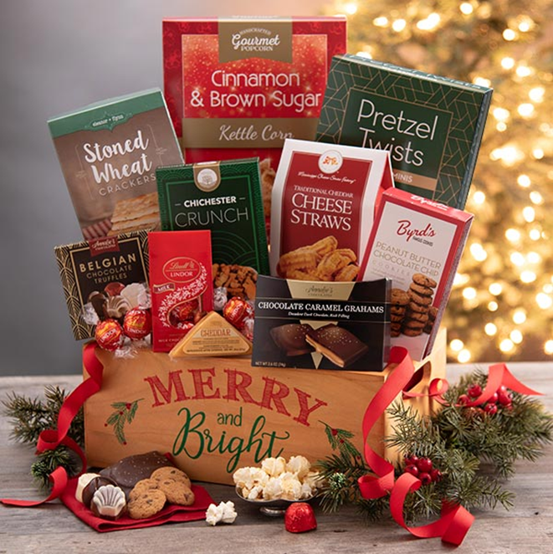
Company Details
Our company is a multi-channel company that utilizes retail stores, catalog mailings and website promotions to drive sales
The brand , although anonymous, is well established and has a strong positive reputation with a good long term customer loyalty
The company is known for selling food products which are often purchased as gifts during the Holiday season

Slide 4

Primary Question
How do we predict and utilize CLV to understand our customer base?

Slide 5
Data
The DMEF dataset consists of 4 files that have been extracted from the company’s marketing database (2001-2007) and that can be linked based on customer ID numbers.
We only used 2 of the four datasets
The original customer dataset (DMEFExtractSummaryV01) had 100,051 customer records that have a customer ID, buying activity summarized by channel for 8 seasons including:
Channel summary
Gift recipients counts by season
Catalog and e-mail circulation counts by season for 6 seasons
First order characteristics
Overlay demographic and psychographic data
Estimated distance to a retail store
Contact records (DMEFExtractContactsV01) which include 3,389,329 marketing contact records.
Customer ID
The contact date
The type of contact

Slide 6
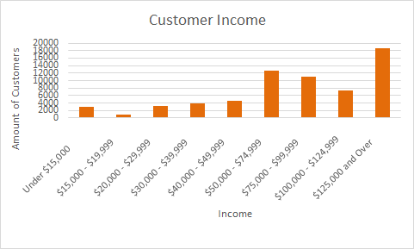
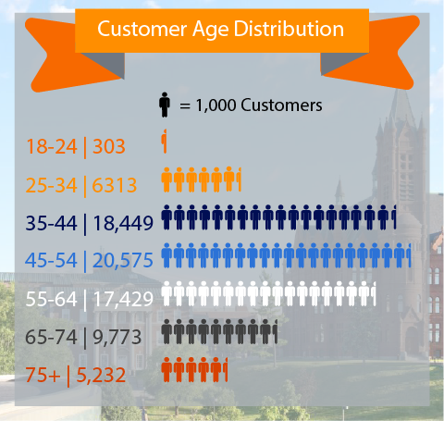
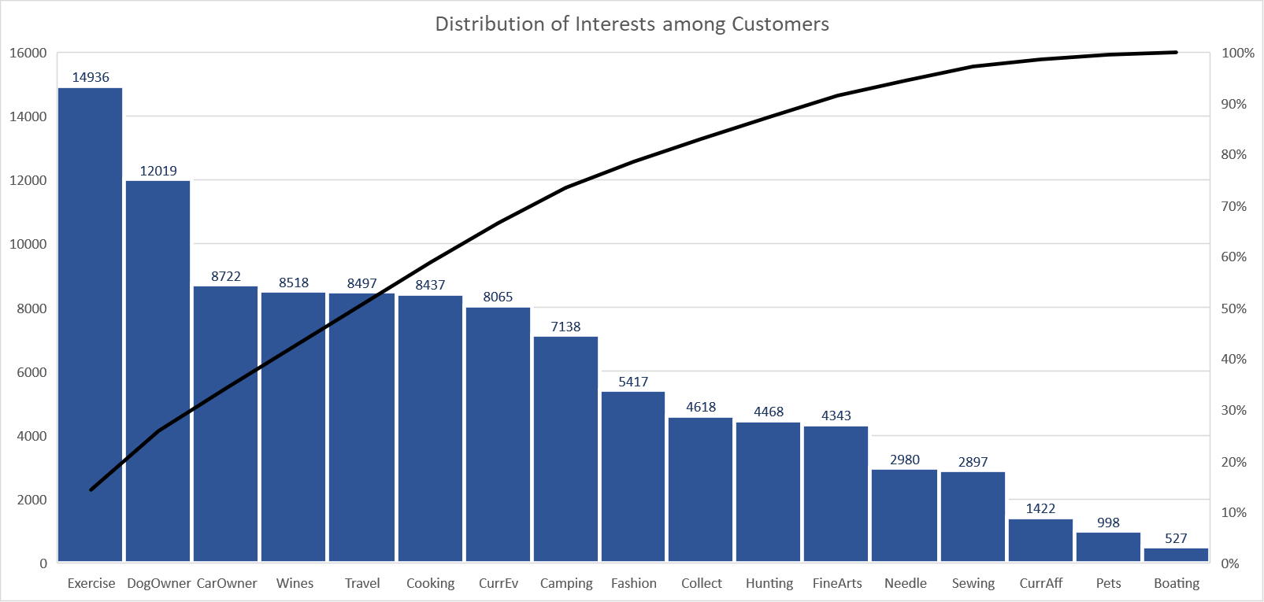
Population Demographics

Slide 7
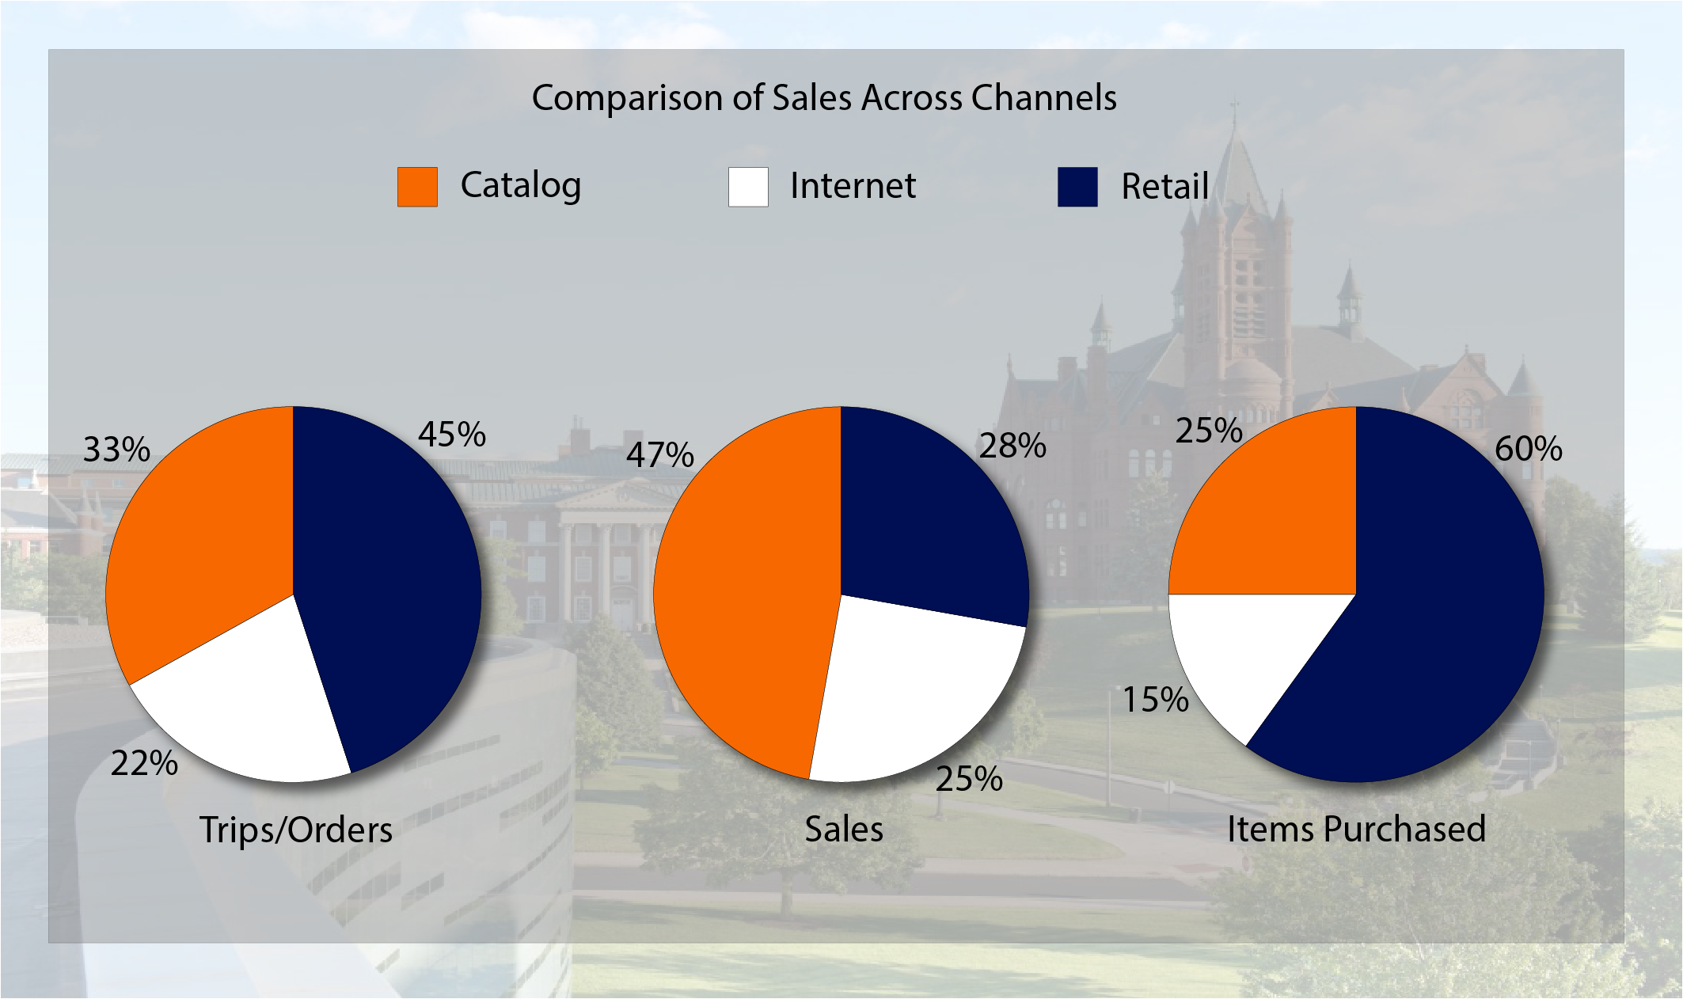
Channel Demographics

Slide 8
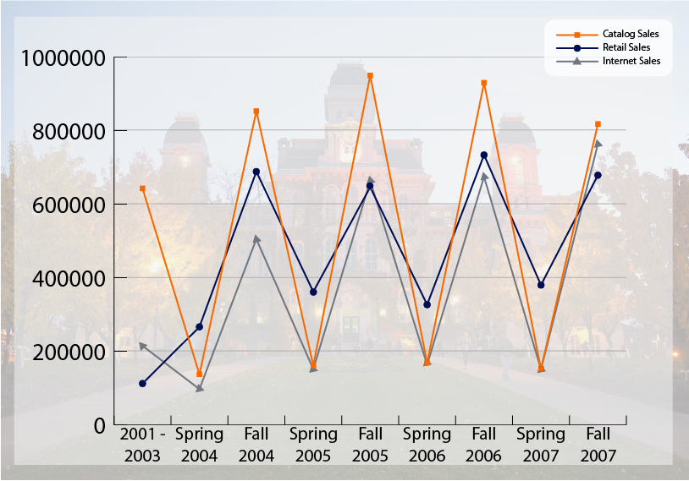
Spending per Channel Over Time

Slide 9
Review of CLV- equations and assumptions
CLV- a discounted sum of all future customer revenue streams minus product, servicing and remarketing costs
Traditional equation predicts future CLV, but must add that to observed customer purchases to evaluate
CLV = [$M-$R]*[(1+d)/(1+d-r)]
Parameters for CLV estimations | Value
Discount (d) | 0.07
Retention rate (r) | 0.8
COGS (Cost of Goods Sold) | 70% of Sale revenue
Catalog cost | $2
Email cost | $0.10
Time Until Customer Assumed Dead | 1.6 * Mean Time Between Orders

Slide 10
Challenges predicting CLV
Dataset Issues
Sales for the years 2001-2003 were aggregated together
No sales records for between the years 1988-2000
Aggregate sales granularity only Fall vs. Summer, not more specific (e.g., month)
Business Model
Sales are not on a subscription-based model
No dedicated data on customer retention
P(alive) is tough to compute due to the infrequent nature of purchases
Implications
CLV did not seem to vary much between different customer segments
CLV was very tough to predict
CLV was biased towards recent buyers b/c of P(alive) difficulties and infrequency of long-term customers

Slide 11

Different approaches/methods for determining CLV
K-means clustering
Regression models
Linear
Logistic
Ensemble ML
XGBoost

Slide 12
Marketing Outreach Trends
Outreach and Customer Revenue are probably in a two-way causal relationship; using correlation with a grain of salt
Correlations Indicative of Company Behavior
Emails Sent <-> Catalogs Sent: 0.311734
Emails Sent <-> Internet Proportion: 0.256344
Catalogs Sent <-> Catalog Channel Proportion: 0.397442
Catalogs Sent <-> Catalog Channel Dollars: 0.491277
Emails Sent <-> Internet Channel Dollars: 0.159728

Slide 13
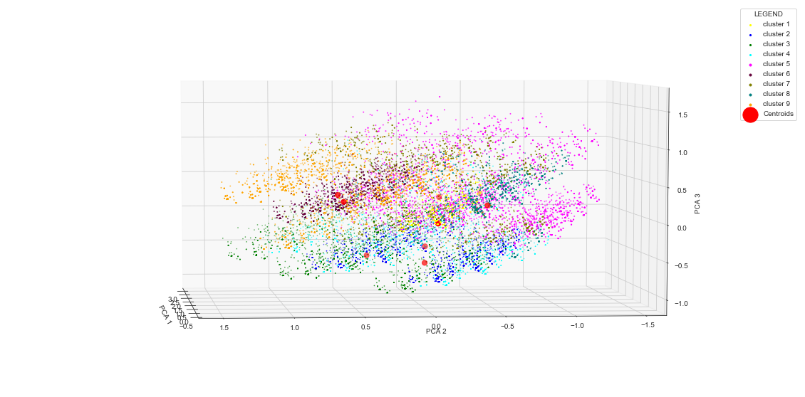
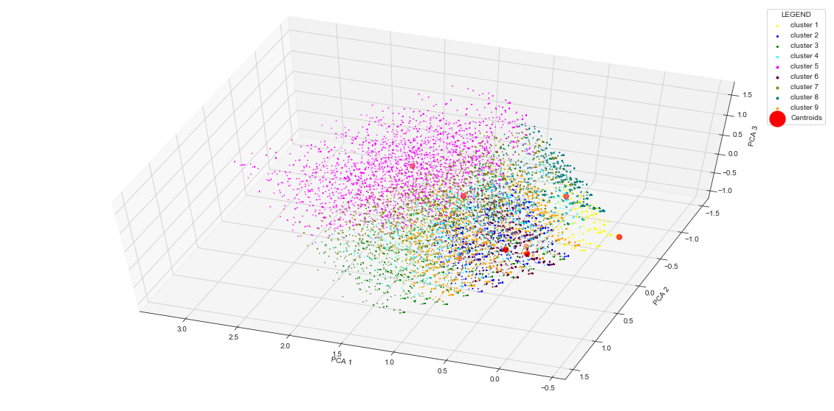
K-Means Customer Segmentation
Only clustered on interests, cluster CLV averages taken after clustering
Elbow method suggested 4 clusters, but using 9 gave more insight
Largest by cluster far was people who did not answer yes to any interests; perhaps many took the survey but did not even read it

Slide 14
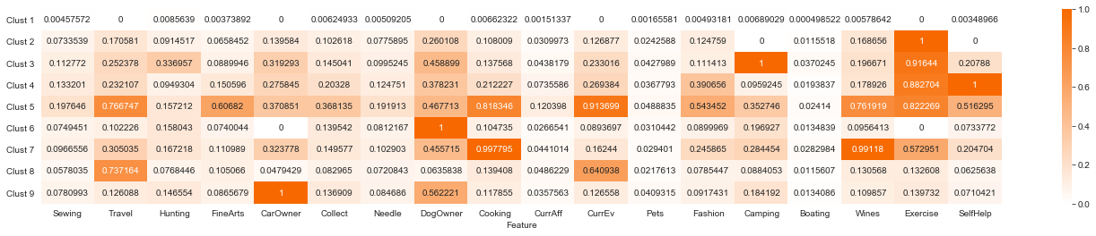
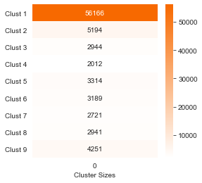
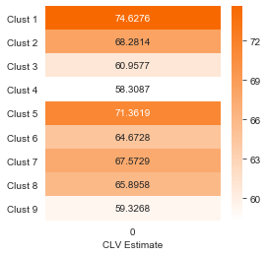
K-Means Customer Segmentation
#5 many interests, highest CLV
#7 Wine & Cooking, high CLV
#2 Exercise but little else, high CLV
#9 Car Owners, #3 Campers, and
#4 Self-Help fans have low CLV

Slide 15
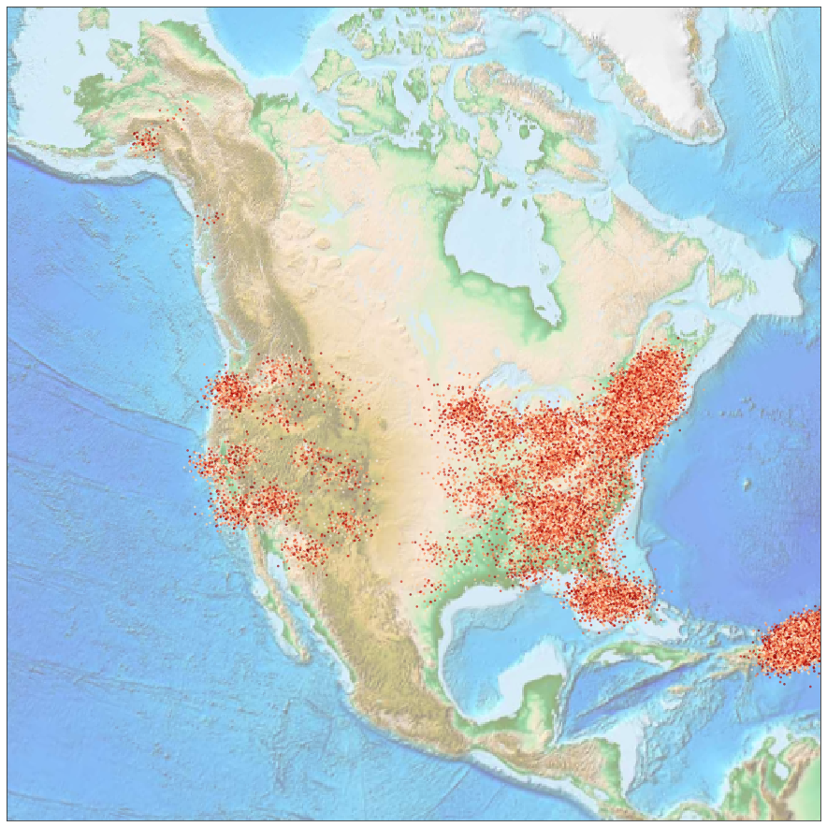
CLV by Location
Most customers are from East coast and Puerto Rico
Perhaps most stores on Eastern seaboard
Would expect more homogeneity in the age of internet
Represents only US based shoppers

Slide 16
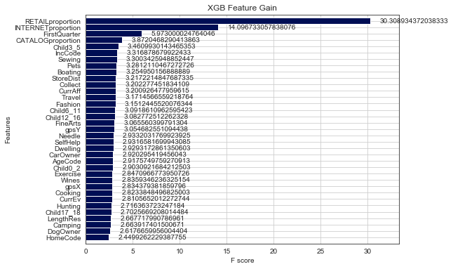
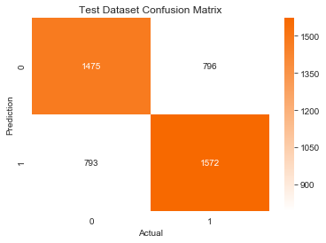
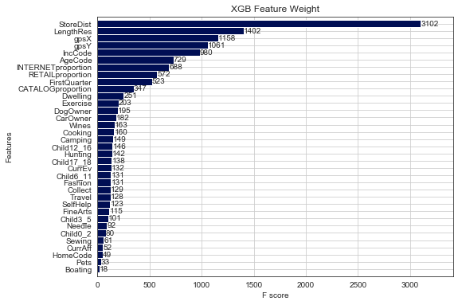
Predict Above-Below Median CLV
CLV Discretized Above-Below Median
65.7% Validation Accuracy
Assumptions | Value
Discount (d) | 0.07
Retention rate (r) | 0.8
COGS | 70% of Sale revenue
Catalog cost | $2
Email cost | $0.10
Time Until Assumed Dead | 1.6 * Mean Time Between Orders

Slide 17
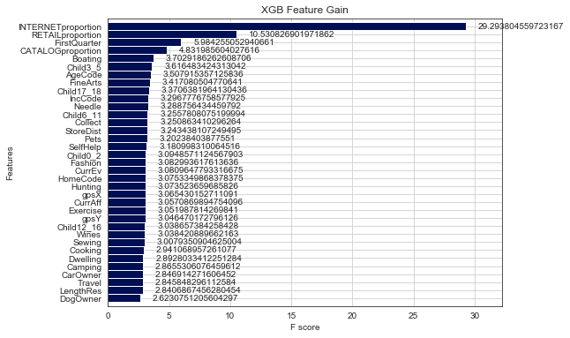
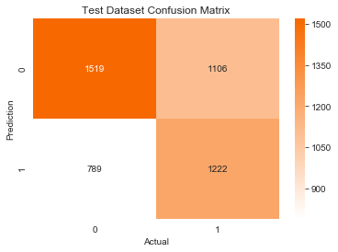
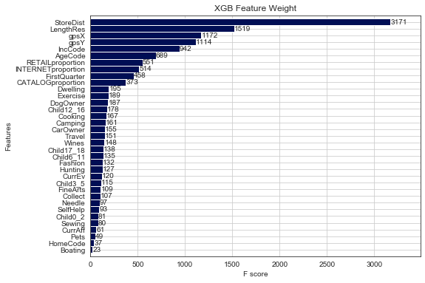
Predict Above-Below Median CLV
Low Cost Assumption
59.1% Validation Accuracy
Assumptions | Value
Discount (d) | 0.07
Retention rate (r) | 0.8
COGS | 65% of Sale revenue
Catalog cost | $1
Email cost | $0.05
Time Until Assumed Dead | 1.6 * Mean Time Between Orders

Slide 18
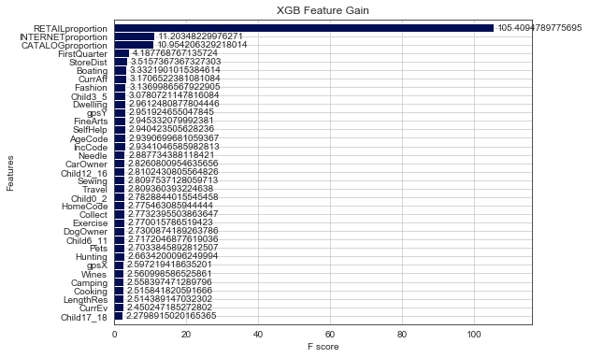
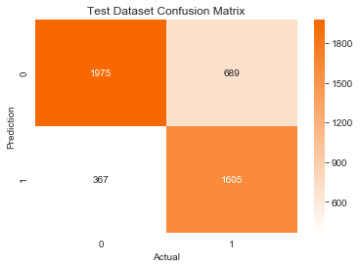
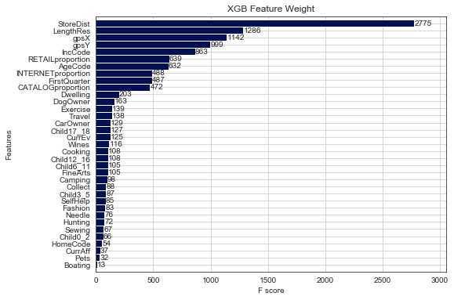
Predict Above-Below Median CLV
High Cost Assumption
77.2% Validation Accuracy
Assumptions | Value
Discount (d) | 0.07
Retention rate (r) | 0.8
COGS | 75% of Sale revenue
Catalog cost | $3
Email cost | $0.15
Time Until Assumed Dead | 1.6 * Mean Time Between Orders

Slide 19
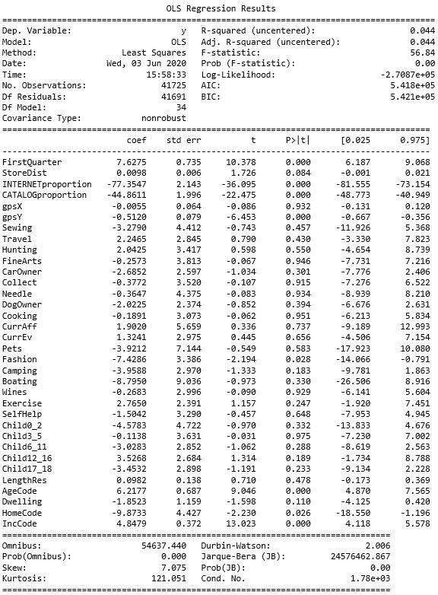
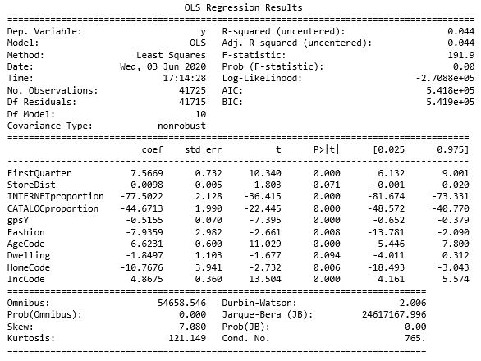
CLV Linear Regression
High Cost Assumption
Assumptions | Value
Discount (d) | 0.07
Retention rate (r) | 0.8
COGS | 75% of Sale revenue
Catalog cost | $3
Email cost | $0.15
Time Until Assumed Dead | 1.6 * Mean Time Between Orders

Slide 20
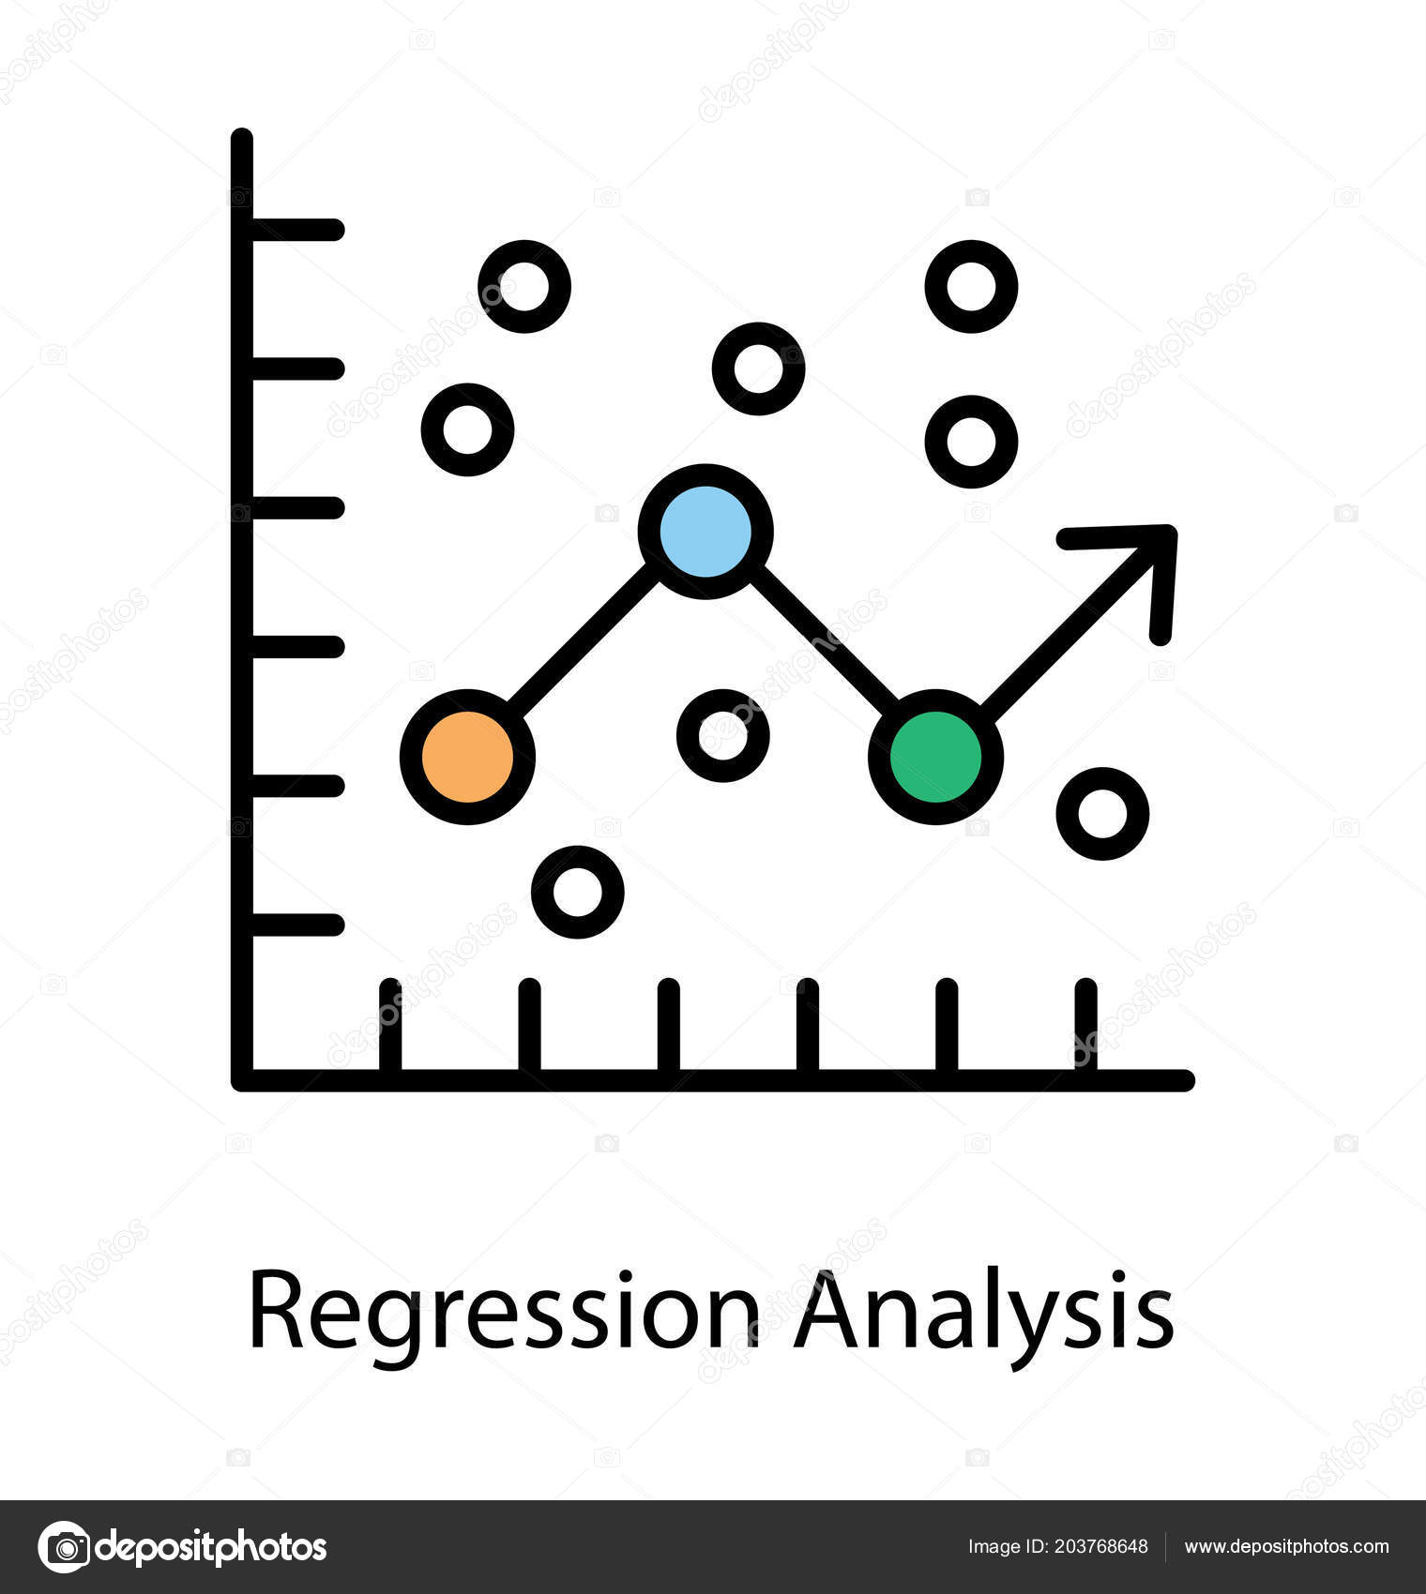
Could we have used Regression to model?
Explored using demographic data to predict estimated CLV
Linear regression to directly predict
For logistic regression, estimated CLV was discretized
Explored multiple configurations
Multiple bins (4-10)
Bins based on distribution
Evenly sized bins

Slide 21
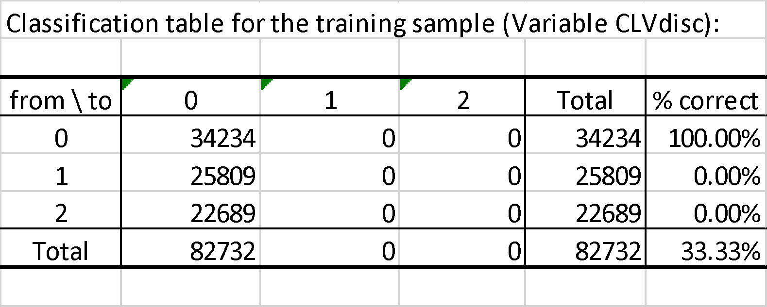
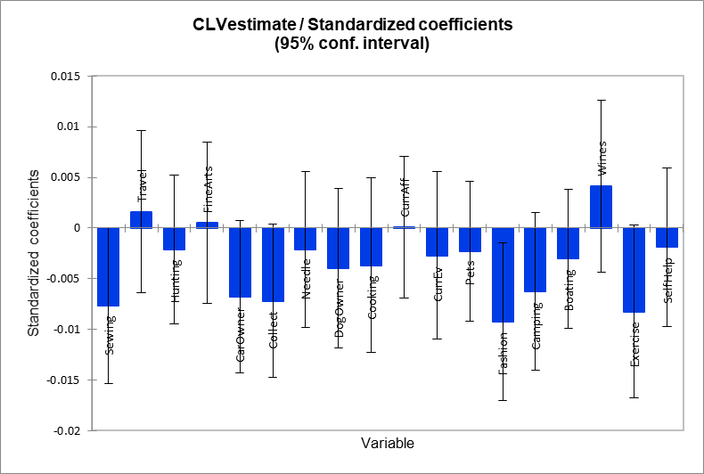
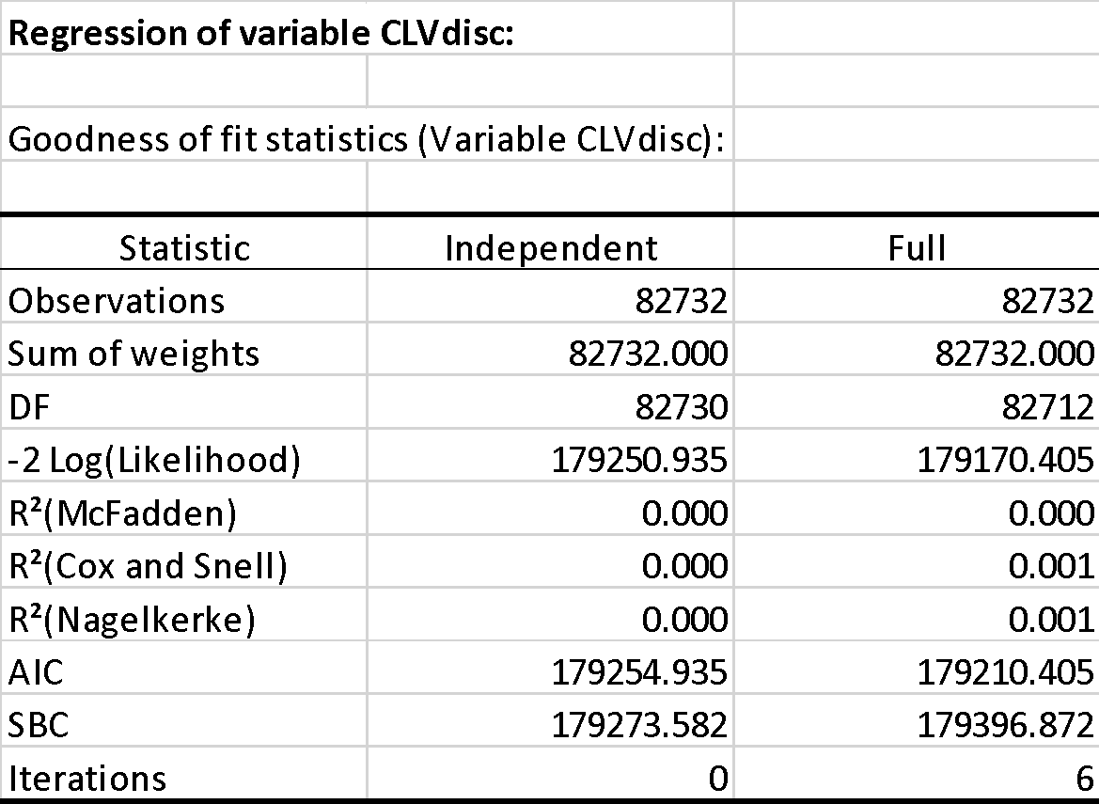
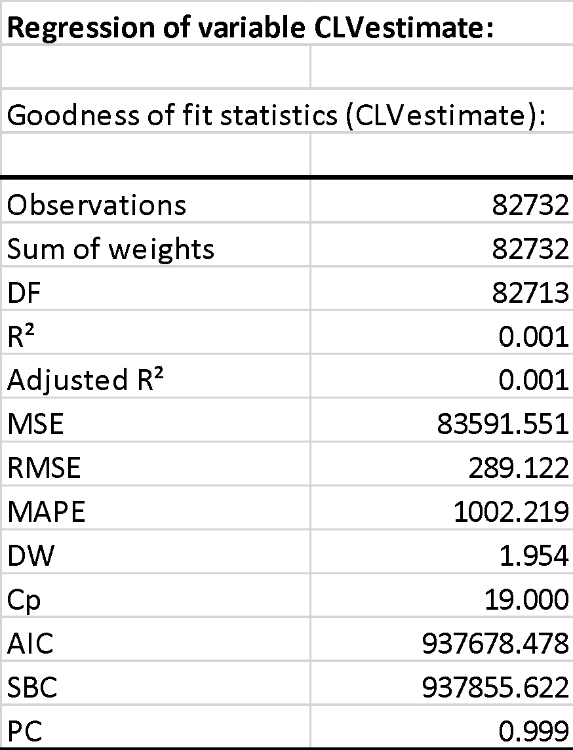
Regression Analysis of CLV
Linear Regression
Logistic regression

Slide 22
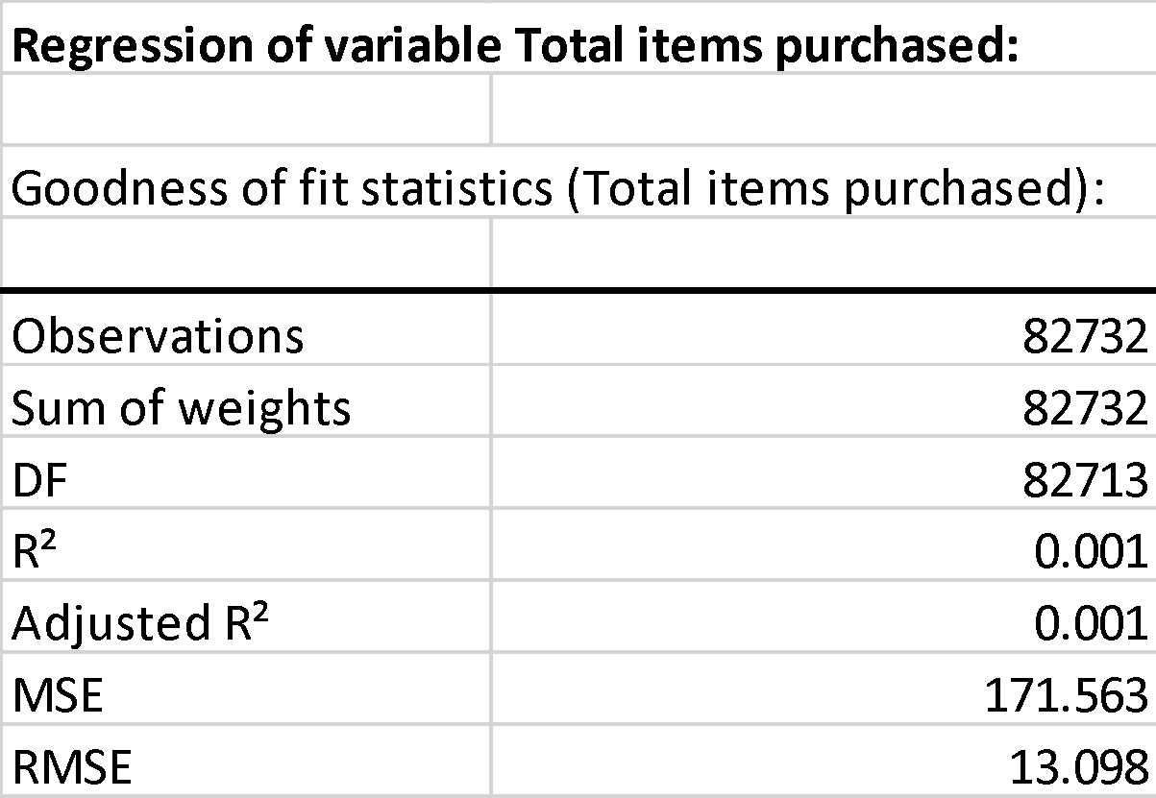
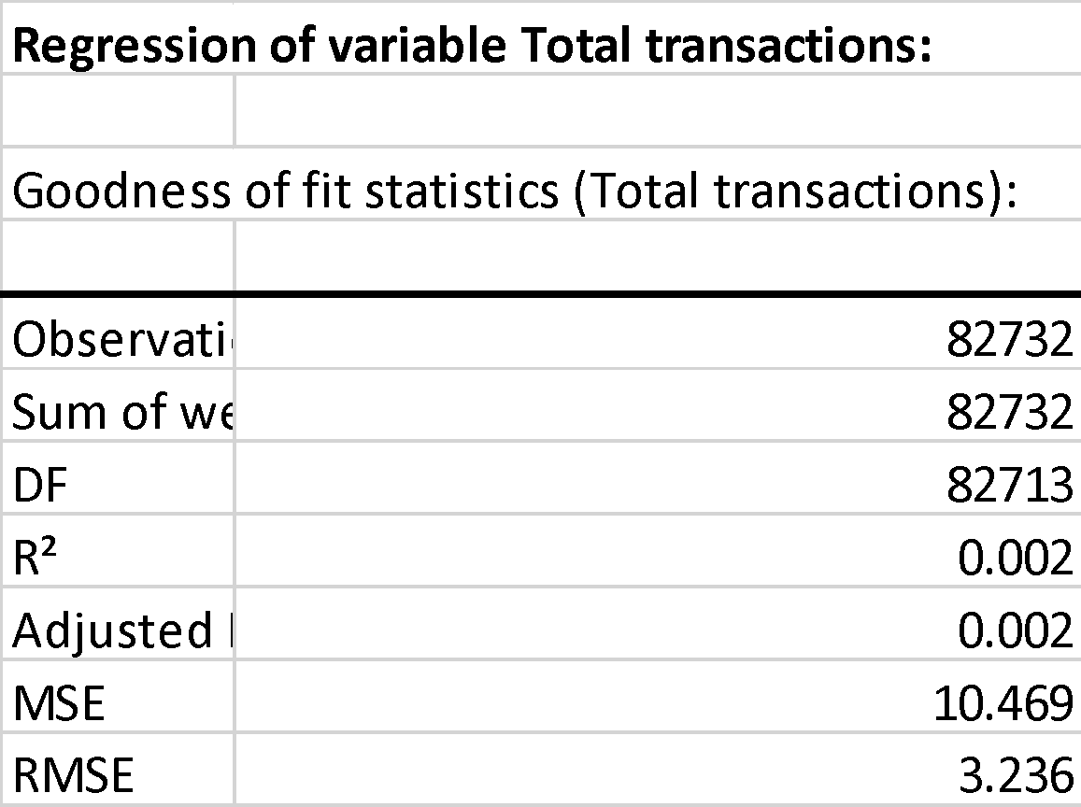
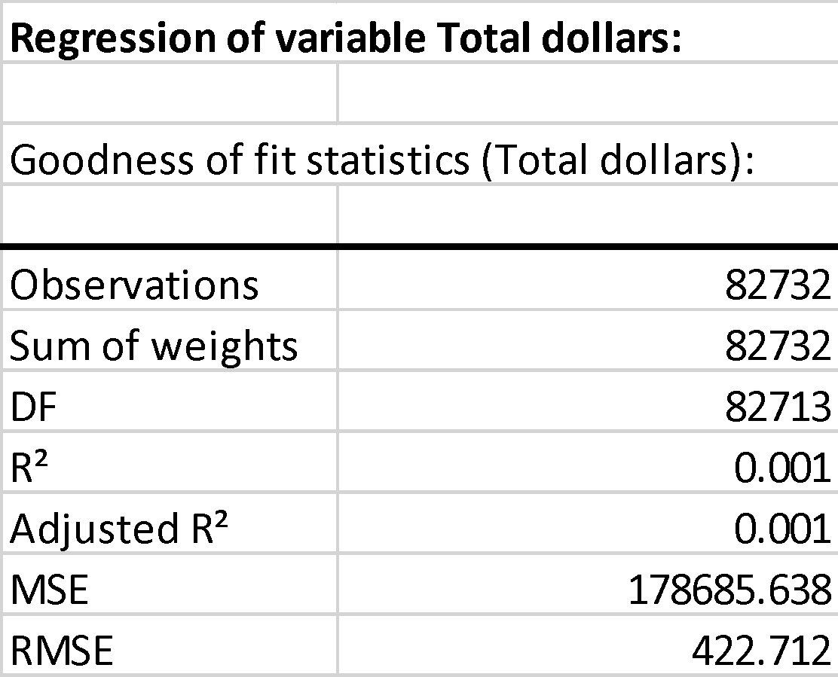
Snapshot of failures

Slide 23
Insights and recommendations
Data was likely poorly collected and documented
Large number of nulls required minimizing feature inclusion
Predictive Model of CLV | Predictability
Linear Regression | Very Poor (R² = 0.001)
Logistic Regression | Very Poor (R² = 0.001), default prediction
K-Means | Not predictive of CLV, but provides demographic insight
XGBoost

